Slide 1
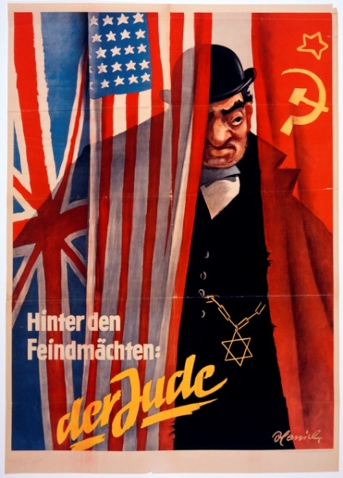
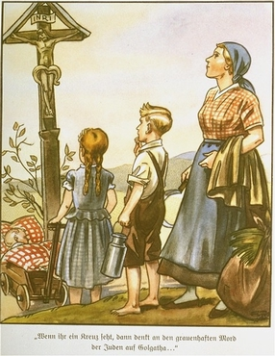
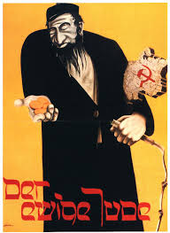
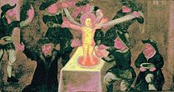
Teaching the History of Antisemitism
Notes:
Fresco in St Paul's Church in Sandomierz, Poland, depicting blood libel

Slide 2
Rationale
Why teach the history of antisemitism in Europe?
  May not know what it is or means
  Gives historical context
  Helps students begin to understand Judaism
  Helps students begin to grasp culture that Nazi Fascism developed
  By knowing where prejudices come from, students can combat them
    As well as the end point of prejudices

Slide 3
Before you begin
Talk to your administration
Christian Church as a political unit

Slide 4
A brief History of Antisemitism in Europe

Slide 5
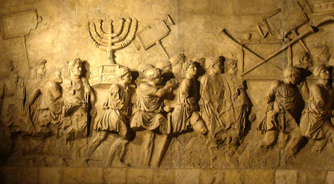
Antisemitism
prejudice against or hatred of Jews
1870’s
  Hebrew – Semitic language
    Jews= “Semites” – but no such thing
Traditionally- Religious based
1870’s- “racial” antisemitism
Notes:
From Yad Vashem
The word is an example of the Jew haters tried to act scholarly /scientific
Racial Antisemitism – social Darwinism- Jews and inferior race- since it is genetic can’t be changed through assimilations

Slide 6
Jews 586 BCE-135 BCE
Monotheistic in a Polytheistic World
  Indivisible
Conquered peoples
Under the Persians
Notes:
Most cultures worship idols or gods they could see or depict
Generally when a people was conquered they adopted the new gods- Jews did not- which set them apart
Persians- Jews seen as lazy because the refused to work one day a week

Slide 7
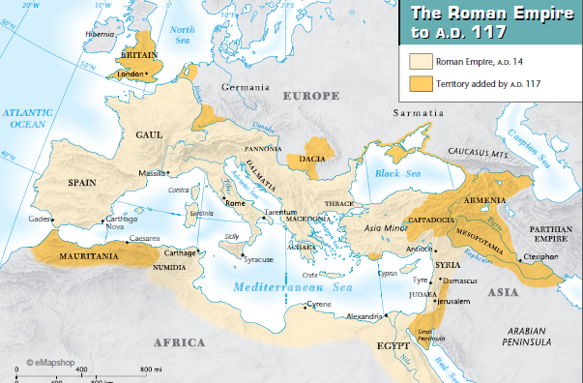
Jews Under the Roman empire
Won’t worship Roman gods
Kept cultural identify
  outsiders
  Fought Roman rule
Removed from Palestine (modern day Israel)- 72 AD
  Europe and Russia (outside of Roman Empire)

Slide 8
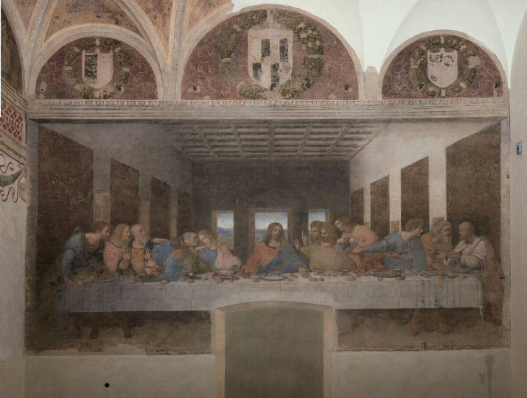
The Jews and Jesus
Jesus =Jew
Roman’s crucified Jesus
Jesus’ followers= Jews
Separation of Jews and Christians took generations
Notes:
The question of whether the Jews of the day were responsible implies a much great Jewish unity and influence on Roman decisions than history shows

Slide 9
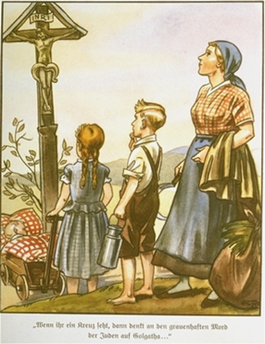
Anti-judism in the Christian church
Early Christian Church
  2 main issues w/ Jews:
    Refused to convert to Christianity
    Responsible for the death of Jesus
      Gospels
Seen as different/outsiders
Notes:
Church as in church structure.
Gospels implied Jews groups worked with Pontius Pilate- written 40-70 years after Jesus’ death, may have been influenced by the setting in which Christians no longer saw themselves as Jews
Galatians – Mosaic Law

Slide 10
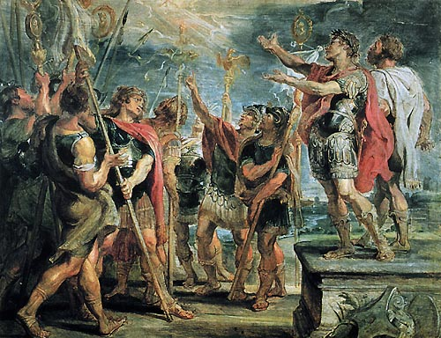
Constantine 312 CE
End Roman Persecution of Christianity
Saw Jews as dangerous
Subsequent leaders embrace Christianity- spread
Notes:
Constantine's conversion Rubens
Gave Christians the right to worship, built churches – begin of the formal organization of the Christian church- no long rag tag groups meeting in homes

Slide 11
Anti Jewish Laws
500’s- Laws protect Christians from Jewish “contamination”
700’s – No Jews in Public Offices
  Jews can’t employ Christians

Slide 12
Jews and Christians in Europe after Rome
Jews outsiders in a Christian Europe dominated by Church
Lived/worked among Christians
  St. Augustine
    Contempt for Jews
    Toleration for right to practice religion
Notes:
St. A saw Jews as a constant reminder that Christianity had replaced Judaism as the true faith, their loss of power showed what happened when you reject God’s truth
Showing contempt for Jews became away of affirming faith
France- custom of assaulting Jews at Easter

Slide 13
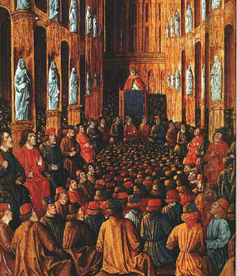
Crusades
11th Century
  Crusaders target Jews- Pope Urban II approves
  Political Power is linked to be Christian
  Anyone not Christian is the enemy
  Jews flee towards Eastern Europe
Notes:
Highlight- this is a political move!! Pre- printing press- “dark ages”
Sent out to fight God’s enemies including Jews

Slide 14

Blood Libel
Myth -1144 CE
  Accused Jews - using blood of Christian (children) in religious celebrations
  Completely untrue- but rumor persists
Notes:
Blood believed to be a source of power,
Jews- blood contains the spirit of a human
Jewish dietary laws 0 animals slaughtered in a way that the blood drains quickly- not to come in contact with blood
Christmas Day 1235- Fulda Germany – Jews accused of murdering 5 children for their blood- why make the lie children- some how worse!
Miller and wife- come home to find mill burned, 5 sons dead- blame the Jews- murdered the boys- put blood in waxed bags. Why?? Doesn’t matter
Took kids bodies to Frederick II – told story the whole way- Frederick could find no evidence –absolved of crime- ignored
Pope Gregory X agreed- none the less- the rumor spread (students will get this- the more sensational- the more a rumor spreads)

Slide 15
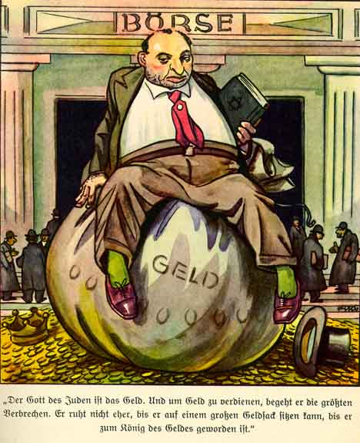
1400’s
Jews forced out of many profession
  Exception banking
    Christians not allowed to charge interest
    Also against Jewish law
      Only profession left for them
      Stereotype- Jews are greedy

Slide 16
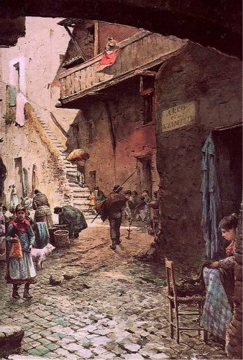
1700’s
Jews Forced into ghettos in many countries
  Gated- guarded by Christians
  Blame for the Plague

Slide 17
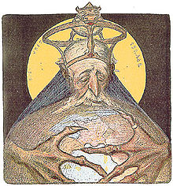
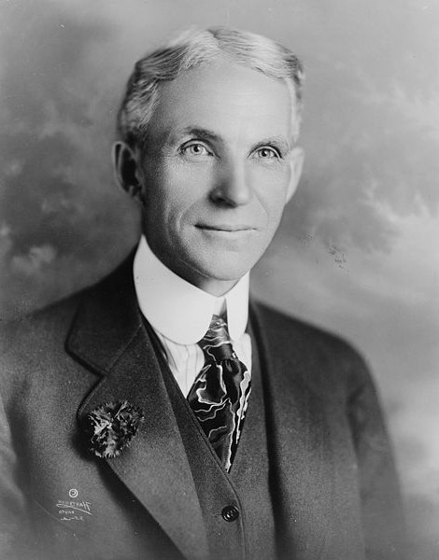
The Protocols of the Elders of Zion
Early 20th Cent-Appears in Europe
  Allegedly proof of Jewish plot to take over the world
  Spread after WWI
  Backed in the US by people like Henry Ford
Completely fake!!

Slide 18
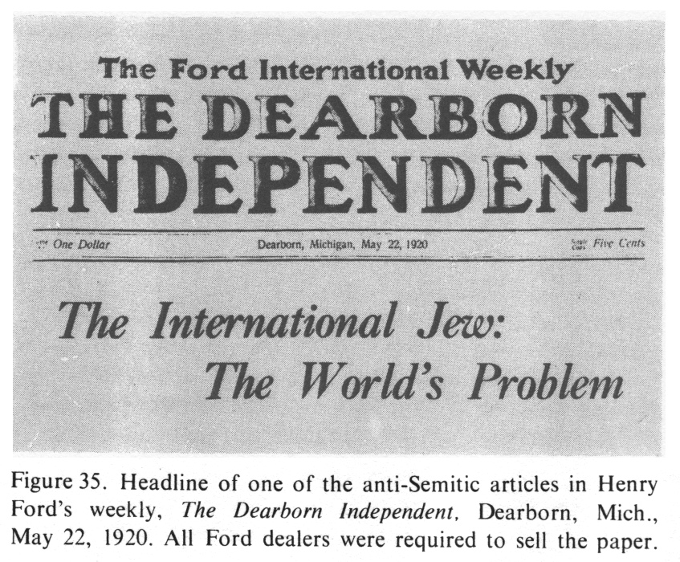
The protocols of the elders of zion

Slide 19
20th Century Social Darwinism
Races are not equal
White race superior
Eugenics – the “science of race”
  Ethnic/Racial Traits passed through genes
  Conversation doesn’t not keep Jewish “traits” from being passed down
  Jews- pollute/weaken the gene pool
Notes:
"Holocaust History." Antisemitism in History: Racial Antisemitism, 1875–1945. Accessed April 23, 2013. http://www.ushmm.org/wlc/en/article.php?ModuleId=10007171.

Slide 20
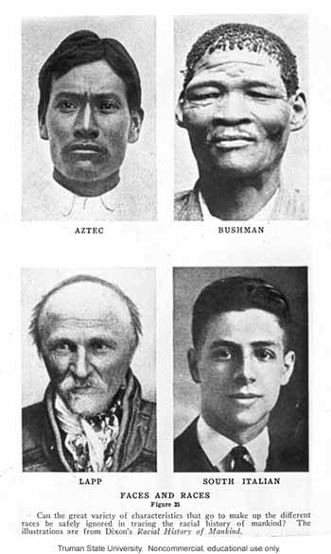
20th century social darwinism

Slide 21
Key Points
Jews were outsiders in a Christian Europe
Target because they refused to conform
1st a religious issue
  A challenge to the Political/Social Power of the Church
Later- a racial issue
  Develop of Racial ideas (Social Darwinism)
  Old religious based stereotypes
  Racial traits unchangeable
THE PERFECT STORM

Slide 22

Resources
A Convenient Hatred: The History of Antisemitims
  Facing History and Ourselves
State of New Jersey Holocaust Curriculum
  http://www.state.nj.us/education/holocaust/curriculum/
Yad Vashem
USHMM Voices on Antisemitism Podcast
  http://www.ushmm.org/confront-antisemitism/antisemitism-podcast
Notes:
Podcast
David Draiman
February 2, 2012
As frontman for the multi-platinum hard-rock band Disturbed, David Draiman writes songs that are often personal and political. As a kid, he was drawn into occasional fistfights over anti-Jewish remarks. As an adult, he addresses Holocaust denial and antisemitism in his song "Never Again.”
Frank Meeink
March 3, 2011
In his book Autobiography of a Recovering Skinhead, Frank Meeink describes with brutal honesty his descent into bigotry and violence as a teenage neo-Nazi. Through some surprising personal encounters, Meeink came to reject his beliefs and become an advocate for tolerance and diversity.

